Slide 1
Parking Assistance Sensors
Abhishek Jasti

Slide 2
AGENDA
Introduction to Ultrasonic Sensors
Function of Sensors
Mathematical Model
Algorithm
Circuit Diagram
DTC and Troubleshoot
Research and Resources

Slide 3
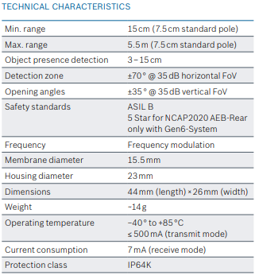
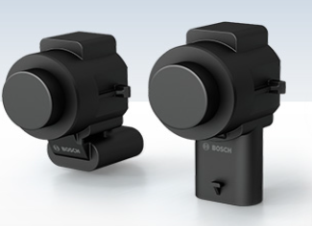
INTRODUCTION To ultrasonic sensors
USS Generation 6
A device that uses high-frequency sound waves beyond the range of human hearing to measure distances and detect objects.

Slide 4
Function of Sensors
Obstacle Detection
Parking Aid
Audible Alerts
Object Avoidance
Front and Rear Parking Assistance
Distance Measurement

Slide 5
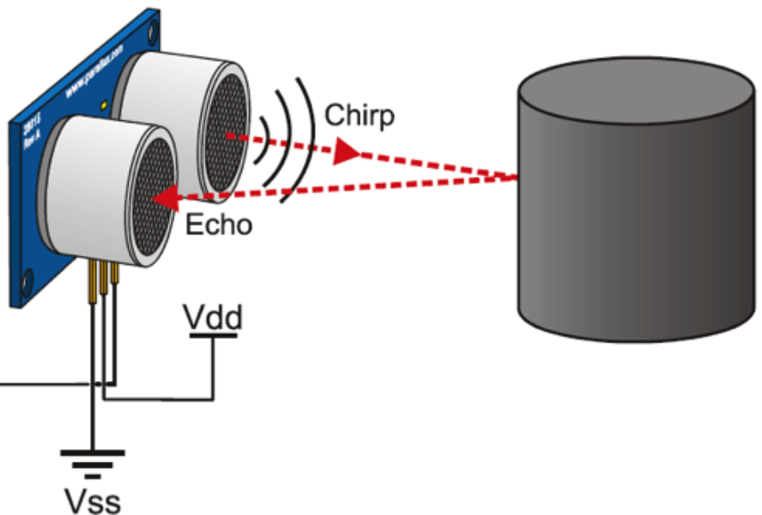
Mathematical model
v x t
Distance = ____
2
Speed of Sound in the air (v)
Approx. 343 meters per second or 1125 feet per second
Time (t)
Amount of time it takes for the pulse to travel to the object and back
Divided by 2 to get the distance measurement
Adjustment for Temperature
v = 331.4 + 0.6 x T

Slide 6
Algorithm
Sensing
Distance Calculation
Data Processing
Sensor Fusion
Obstacle Detection and Warning
Integration with Vehicle Systems

Slide 7
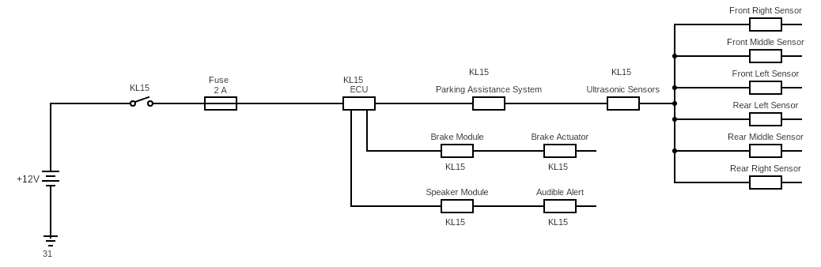
Circuit

Slide 8
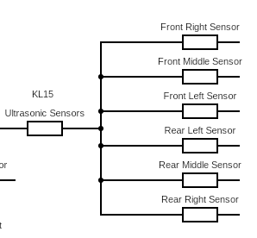
All Front and Rear Sensors are covered in the circuit.

Slide 9
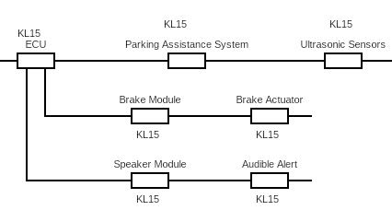
Integration of the ECU to the brake module and the speaker module

Slide 10
DTC Troubleshoot
P0428 – The Sensor’s circuitry issue
P0429 – Sensor detects low voltage
P0430 – Sensor detects high voltage
P0431 – The sensor is not sending a signal
P0433 – Sensor signal is blocked
U0100 – Error between the communication of sensor and ECU
Could be a wiring problem or a faulty sensor
Could be a short circuit
Could be an open circuit
Sensor could be disconnected or damaged
Dirt and debris build up on the sensor
Ask a mechanic

Slide 11
References and Resources
CIRCUIT DESIGN HELP:
Electric Wiring diagrams BMW X7 - https://vladgur.com/workshop-manual/bmw-x7-50i-g07_2019_edition-12.2019_ewd_ag/?page=115
TDK Product Sensor - https://product.tdk.com/en/techlibrary/applicationnote/park-assist_sensor-disk_ultrasonic_mlcc.html
Online Circuit Creator - https://www.circuit-diagram.org/editor/
Technical Details:
Bosch Website - https://www.bosch-mobility.com/en/solutions/sensors/ultrasonic-sensor/
Datasheet:
Bosch Datasheet - https://atleducation.org/wp-content/uploads/curriculum/adas/product-data-sheet-ultrasonic-sensors-generation-6.pdf

Slide 12
THANK YOU

